Slide 1
Reading a File in Python
DVT101 – Lecture 46
- By Dataverse Tutorials

Slide 2
Introduction to Reading Files in Python
What does reading a file mean
Difference between program data and file data
Why reading files is a core Python skill
Where file reading is used in real life

Slide 3
Why File Reading is Important
Accessing previously stored data
Handling external data sources
Avoiding hardcoded values in programs
Role in automation and data processing

Slide 4
Types of Data We Read from Files
Text data concept
Binary data concept
Structured data formats overview
How Python differentiates file content

Slide 5
File Reading Workflow
Locating the file in the system
Opening the file safely
Reading data into the program
Closing and releasing resources

Slide 6
File Read Modes Overview
Read mode purpose
Difference between text and binary read
Default behavior of read mode
When incorrect mode causes errors

Slide 7
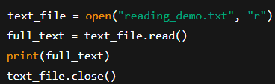
Reading Entire File Content
Concept of full file read
How data is loaded into memory
Pros and limitations of full read
Suitable use cases

Slide 8

Reading a File Using with Statement
Automatic file management concept
Why manual closing is risky
Cleaner and safer approach
Industry-recommended practice

Slide 9
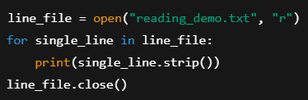
Reading Files Line by Line
Why line-by-line reading is needed
Memory efficiency benefits
Sequential data processing idea
Log and dataset processing use cases

Slide 10
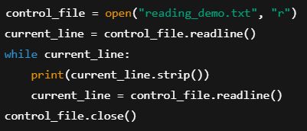
Line-by-Line Reading Techniques (Readline)
Loop-based reading concept
Single-line reading idea
Controlling whitespace and formatting
Choosing the right technique

Slide 11
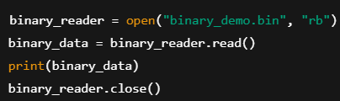
Reading Binary Files
What binary files are
Why binary mode is required
Difference between text output and byte output
Real-world binary file examples

Slide 12
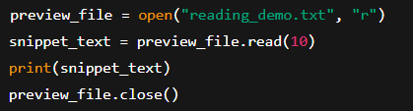
Reading Specific Portions of a File
Partial file reading concept
Limiting data read size
Performance optimization idea
Previewing large files

Slide 13
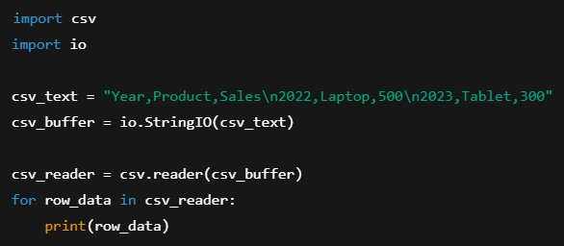
Reading CSV Files Conceptually
What CSV files represent
Tabular data storage idea
Row and column based reading
Common industry use cases

Slide 14
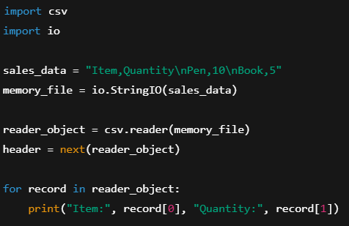
CSV Reading Backend Logic
Parsing comma-separated values
Converting rows into program-friendly structures
Handling headers and data rows
Typical data pipelines

Slide 15
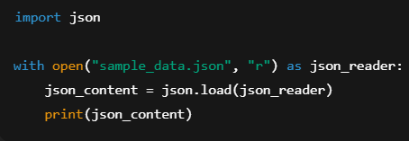
Reading JSON Files Conceptually
What JSON format is
Key-value based data structure
Why JSON is popular in APIs
Relationship with Python dictionaries

Slide 16
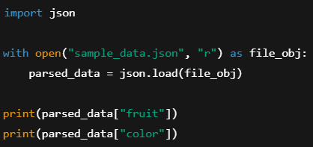
Backend Working of JSON Reading
Parsing structured text
Data conversion into memory objects
Validation and error possibilities
Usage in real applications

Slide 17
Common Mistakes While Reading Files
Forgetting to close files
Reading large files incorrectly
Mixing text and binary modes
Assuming file always exists

Slide 18
Best Practices for File Reading
Choosing correct reading method
Using safe file handling techniques
Optimizing memory usage
Writing production-ready code

Slide 19
Summary & Key Takeaways
What reading files enables
Different reading strategies recap
When to use which method
Transition to advanced data handling

Slide 20


